Slide 1
Minigame Trio
Paul McGlothlin
Computer and Information Sciences
Prof. Julie M. Henderson

Slide 2
Statement of Purpose / Problem Statement
With the advent of the pandemic and isolation becoming a requirement, this project was designed as an entertainment pastime.
Due to the potential inability to interact with others depending on your situation, the program was designed with the ability to play alone in mind.
Includes three minigames that can be enjoyed alone or with a friend, offering variety regardless of your current situation.

Slide 3
Research & Background / Project Language
Game design research was a must, and was the most important part of early theory crafting and research.
If the games are not fun in the first place, the point is moot.
Figuring out what tools I needed to make the program a reality; eventually deciding on SFML (Simple and Fast Media Library) and C++.

Slide 4
Project Requirements
Three functional games, requiring different ruleset implementations and design philosophies.
A working user interface for the user to select between games and tweak settings.
A functional toggle that allows the user to play the games alone or against another human.
Music for immersion, including the ability to lower or turn off the music.

Slide 5
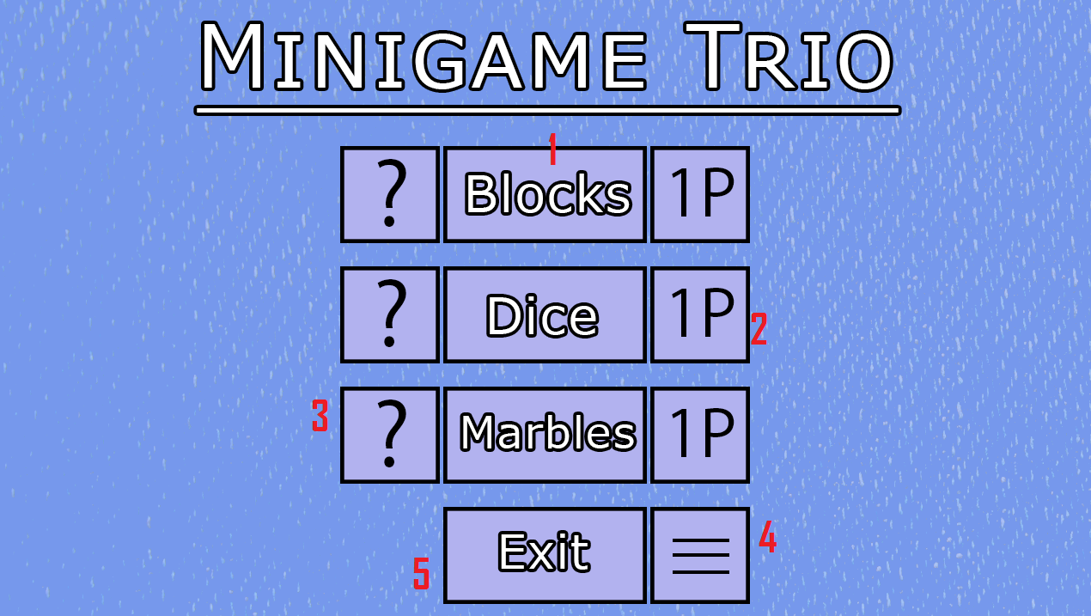
Project Description
The program launches into a title screen where the user can select between a variety of options.
1. Buttons that, when clicked, lead to the three various games.
2. Buttons that toggle between one player (1P) and two player (2P) modes for the games.
3. Buttons that lead to a brief tutorial for each game.
4. Button that leads to a menu with settings that can be changed.
5. Button to exit the program.

Slide 6
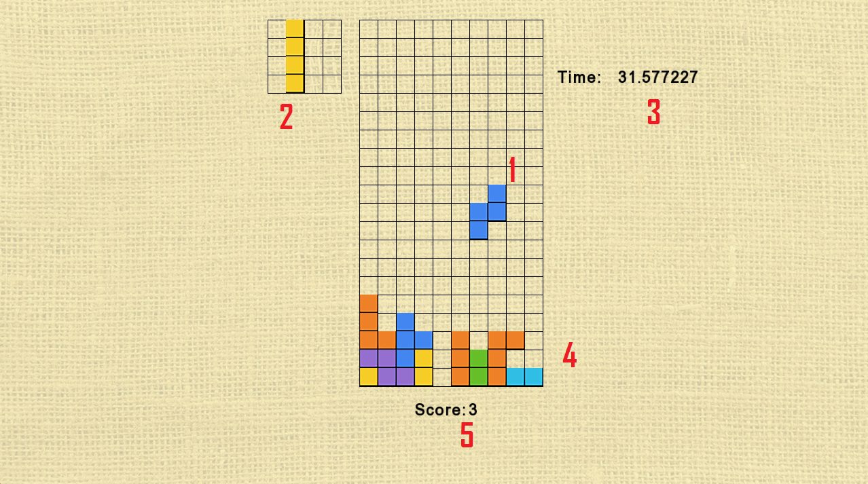
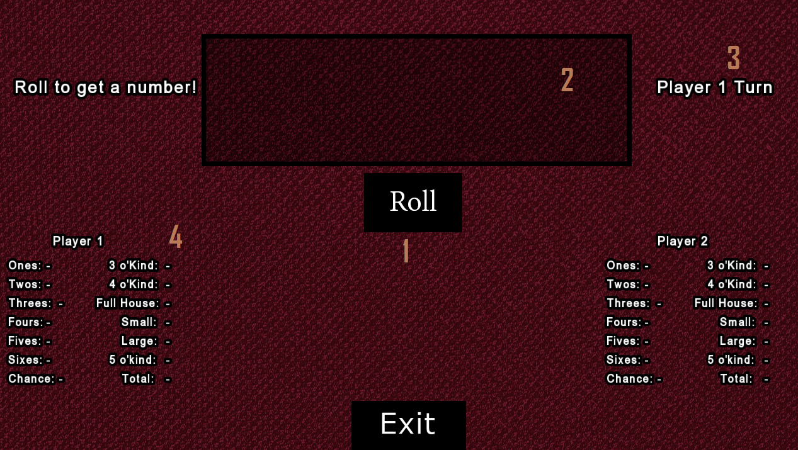
A game of chance that involves rolling dice and fitting them into categories.
1. Button to roll the five dice. Every turn the player can roll up to three times.
2. The field for the die. Individual dice can be clicked to freeze them, preventing rolls from changing them for that turn.
3. A label showing whose turn it currently is.
4. The categories. The player clicks one in order to fit the current die into it.
A game about stacking blocks with various shapes in order to make lines.
1. The blocks that the player controls
2. The next blocks to drop.
3. The timer, raising difficulty over time.
4. The field of blocks that the player has dropped.
5. The player’s current score.

Slide 7
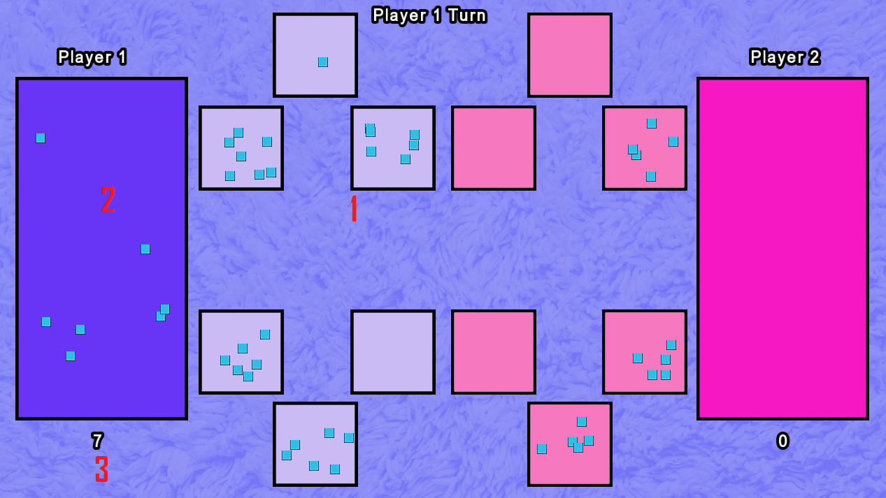
1. The camps for the marbles. The players take turns grabbing all of the marbles from one of their camps and placing the marbles one at a time in camps in a counter clockwise direction until they run out. Ending the turn in an empty one lets you claim extra marbles.
2. The goal. Ending in your own goal gives you an immediate extra turn.
3. The score tracker. A player’s score is the total number of marbles in their goal. The game ends when one player has no more marbles on the field.
A tactical game involving eight camps of marbles that players take turn scattering in a counter clockwise rotation.

Slide 8
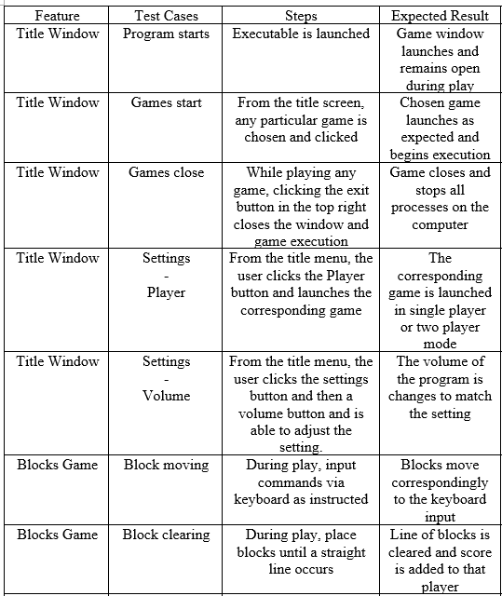
Test Plan
Make sure the player was able to functionally play through each game with the rules intact
AI made competent decisions in Marbles and Dice.
Settings could be changed and would save between sessions.

Slide 9
Challenges Overcome
/ Future Enhancements
Designing the games was harder than expected
Coding Blocks was a much longer process than intended, taking nearly three times as much time as the other two
Mission mode for increased longevity.
Increasing player choice in settings.
Cleaning up the visuals, especially in Marbles.

